Slide 1
Transfer Learning
김동휘

Slide 2
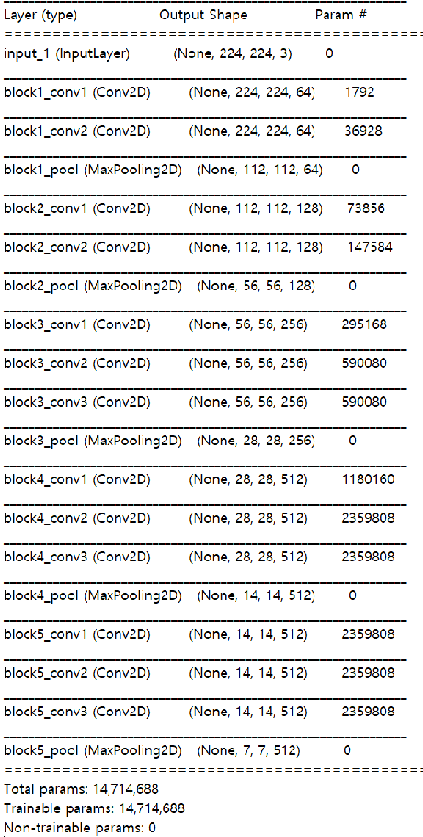
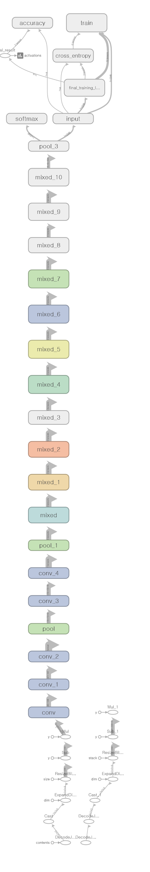

Slide 3
Data
 | Train | Test
Total | 83335 | 1067
CNV | 37188 | 250
DME | 11328 | 250
DRUSEN | 8565 | 282
NORMAL | 26254 | 285
Image_size | 224*224*3
Epochs | 100
Normalization | 0~1

Slide 4
Case1 (original dataset)
 | Case1 | Case2 | Case3 | Case4 | Case5 | Case6 | Case7
모델 | VGG16
Train data | 512 | 1024 | 2048 | 4096 | 8192 | 16384 | 42496
Test data | 1000
model (A) | 1 | 0.99 | 0.968 | 0.967 | 0.936 | 0.967 | 0.959
test | 0.83 | 0.878 | 0.869 | 0.907 | 0.93 | 0.951 | 0.957
CNV | 0.979 | 0.98 | 0.977 | 0.97 | 0.987 | 0.996 | 1
DME | 0.623 | 0.703 | 0.62 | 0.799 | 0.829 | 0.946 | 0.888
DRUSEN | 0.92 | 0.934 | 0.93 | 0.926 | 0.98 | 0.97 | 0.995
NORMAL | 0.802 | 0.893 | 0.949 | 0.932 | 0.92 | 0.894 | 0.947

Slide 5
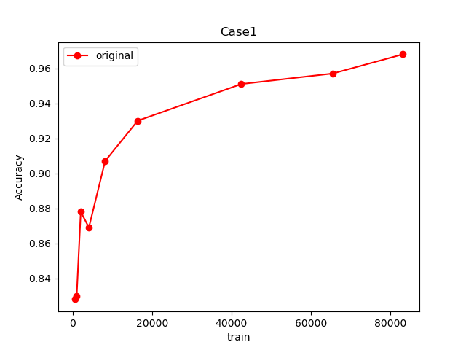

Slide 6
Data
 | Train | Test
Total | 30600 | 3400
CNV | 7650 | 850
DME
DRUSEN
NORMAL
Image_size | 224*224*3
Epochs | 100
Normalization | 0~1

Slide 7
Case2 (1폴더)
 | Case1 | Case2 | Case3 | Case4 | Case5 | Case6 | Case7
모델 | VGG16
Train data | 512 | 1024 | 2048 | 4096 | 8192 | 16384 | 30592
Test data | 3400
model (A) | 1 | 0.976 | 0.984 | 0.970 | 0.960 | 0.933 | 0.953
test | 0.727 | 0,774 | 0.785 | 0.805 | 0.821 | 0.840 | 0.832
CNV | 0.774 | 0.782 | 0.876 | 0.845 | 0.899 | 0.919 | 0.893
DME | 0.72 | 0.737 | 0.847 | 0.802 | 0.763 | 0.860 | 0.829
DRUSEN | 0.696 | 0.778 | 0.695 | 0.786 | 0.742 | 0.754 | 0.771
NORMAL | 0.719 | 0.801 | 0.722 | 0.789 | 0.880 | 0.829 | 0.836

Slide 8
Case2 (2폴더)
 | Case1 | Case2 | Case3 | Case4 | Case5 | Case6 | Case7
모델 | VGG16
Train data | 512 | 1024 | 2048 | 4096 | 8192 | 16384 | 30592
Test data | 3400
model (A) | 0.933 | 0.999 | 0.989 | 0.975 | 0.9604 | 0.942 | 0.941
test | 0.775 | 0.790 | 0.799 | 0.856 | 0.868 | 0.872 | 0.867
CNV | 0.785 | 0.803 | 0.783 | 0.895 | 0.962 | 0.863 | 0.893
DME | 0.831 | 0.765 | 0.793 | 0.842 | 0.849 | 0.865 | 0.837
DRUSEN | 0.810 | 0.791 | 0.774 | 0.820 | 0.837 | 0.918 | 0.896
NORMAL | 0.673 | 0.803 | 0.846 | 0.868 | 0.824 | 0.840 | 0.841

Slide 9
Case2 (3폴더)
 | Case1 | Case2 | Case3 | Case4 | Case5 | Case6 | Case7
모델 | VGG16
Train data | 512 | 1024 | 2048 | 4096 | 8192 | 16384 | 30592
Test data | 3400
model (A) | 0.995 | 1 | 0.971 | 0.95 | 0.95 | 0.965 | 0.952
test | 0.73 | 0.814 | 0.795 | 0.807 | 0.807 | 0.862 | 0.861
CNV | 0.84 | 0.877 | 0.855 | 0.838 | 0.838 | 0.913 | 0.931
DME | 0.64 | 0.867 | 0.776 | 0.723 | 0.723 | 0.910 | 0.847
DRUSEN | 0.66 | 0.777 | 0.797 | 0.792 | 0.792 | 0.827 | 0.794
NORMAL | 0.8 | 0.733 | 0.754 | 0.838 | 0.873 | 0.799 | 0.872

Slide 10
Case2 (4폴더)
 | Case1 | Case2 | Case3 | Case4 | Case5 | Case6 | Case7
모델 | VGG16
Train data | 512 | 1024 | 2048 | 4096 | 8192 | 16384 | 30592
Test data | 3400
model (A) | 1 | 0.994 | 0.998 | 0.977 | 0.948 | 0.96 | 0.936
test | 0.726 | 0.758 | 0.773 | 0.794 | 0.804 | 0.823 | 0.817
CNV | 0.854 | 0.883 | 0.844 | 0.895 | 0.952 | 0.868 | 0.908
DME | 0.718 | 0.809 | 0.785 | 0.753 | 0.736 | 0.806 | 0.856
DRUSEN | 0.658 | 0.677 | 0.707 | 0.686 | 0.749 | 0.731 | 0.790
NORMAL | 0.673 | 0.662 | 0.758 | 0.844 | 0.778 | 0.887 | 0.716

Slide 11
Case2 (4폴더)
 | 1fold | 2fold | 3fold | 4fold | 5fold | 6fold | 7fold | 8fold | 9 | 10
모델
Traindata | 30592 | 30592 | 30592 | 30592 | 30592 | 30592 | 30592 | 30592 | 30592 | 30592
Test data | 3400
model(A) | 0.97 | 0.9577
test | 0.8524 | 0.8450272
CNV | 0.8844 | 0.9089743
DME | 0.8719 | 0.8719806
DRUSEN | 0.7718 | 0.7929864
NORMAL | 8817 | 0.8061674

Slide 12
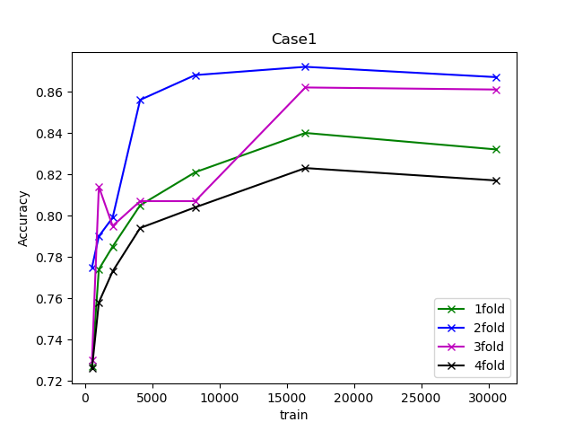

Slide 13
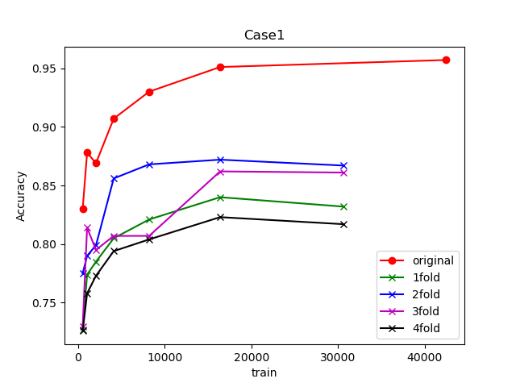

Slide 14
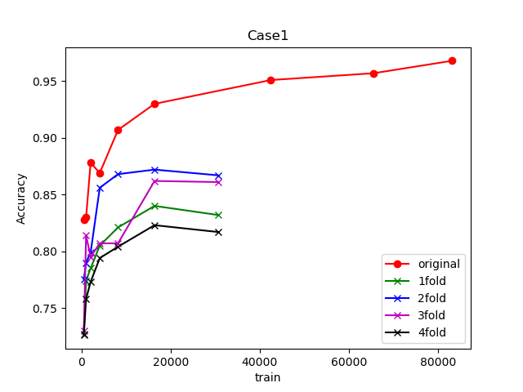

Slide 15
Case2 (4폴더)
 | 1fold | 2fold | 3fold | 4fold | 5fold | 6fold | 7fold
모델
Train data | 30592 | 30592 | 30592 | 30592 | 30592 | 30592
Test data | 3400
model (A) | 0.97 | 0.9577
test | 0.8524 | 0.8450272153
CNV | 0.8844 | 0.908974358
DME | 0.8719 | 0.871980676
DRUSEN | 0.7718 | 0.7929864253
NORMAL | 8817 | 0.8061674008

Slide 16
Case2
 | Case1 | Case2 | Case3 | Case4 | Case5 | Case6 | Case7
모델 | VGG16
Train data | 512 | 1024 | 2048 | 4096 | 8192 | 16384 | 30592
Test data | 3400
model (Acc) | 1 | 0.976 | 0.984 | 0.970 | 0.960 | 0.933 | 0.953
test (Acc) | 0.727 | 0.774 | 0.785 | 0.805 | 0.821 | 0.840 | 0.832
CNV | 0.774 | 0.782 | 0.876 | 0.845 | 0.899 | 0.919 | 0.893
DME | 0.72 | 0.737 | 0.847 | 0.802 | 0.763 | 0.860 | 0.829
DRUSEN | 0.696 | 0.778 | 0.695 | 0.786 | 0.742 | 0.754 | 0.771
NORMAL | 0.719 | 0.801 | 0.722 | 0.789 | 0.880 | 0.829 | 0.836

Slide 17
Case3
 | Case1 | Case2 | Case3 | Case4 | Case5 | Case6 | Case7
모델 | VGG16
Train data | 512 | 1024 | 2048 | 4096 | 8192 | 16384 | 30592
Test data | 3400
model (Acc) | 0.933 | 0.999 | 0.989 | 0.975 | 0.9604 | 0.942 | 0.941
test (Acc) | 0.775 | 0.790 | 0.799 | 0.856 | 0.868 | 0.872 | 0.867
CNV | 0.785 | 0.803 | 0.783 | 0.895 | 0.962 | 0.863 | 0.893
DME | 0.831 | 0.765 | 0.793 | 0.842 | 0.849 | 0.865 | 0.837
DRUSEN | 0.810 | 0.791 | 0.774 | 0.820 | 0.837 | 0.918 | 0.896
NORMAL | 0.673 | 0.803 | 0.846 | 0.868 | 0.824 | 0.840 | 0.841

Slide 18
Case4
 | Case1 | Case2 | Case3 | Case4 | Case5 | Case6 | Case7
모델 | VGG16
Train data | 512 | 1024 | 2048 | 4096 | 8192 | 16384 | 30592
Test data | 3400
model (Acc) | 0.995 | 1 | 0.971 | 0.95 | 0.95 | 0.965 | 0.952
test (Acc) | 0.73 | 0.814 | 0.795 | 0.807 | 0.807 | 0.862 | 0.861
CNV | 0.84 | 0.877 | 0.855 | 0.838 | 0.838 | 0.913 | 0.931
DME | 0.64 | 0.867 | 0.776 | 0.723 | 0.723 | 0.910 | 0.847
DRUSEN | 0.66 | 0.777 | 0.797 | 0.792 | 0.792 | 0.827 | 0.794
NORMAL | 0.8 | 0.733 | 0.754 | 0.838 | 0.873 | 0.799 | 0.872

Slide 19
Case5
 | Case1 | Case2 | Case3 | Case4 | Case5 | Case6 | Case7
모델 | VGG16
Train data | 512 | 1024 | 2048 | 4096 | 8192 | 16384 | 30592
Test data | 3400
model (Acc) | 1 | 0.994 | 0.998 | 0.977 | 0.948 | 0.96 | 0.936
test (Acc) | 0.726 | 0.758 | 0.773 | 0.794 | 0.804 | 0.823 | 0.817
CNV | 0.854 | 0.883 | 0.844 | 0.895 | 0.952 | 0.868 | 0.908
DME | 0.718 | 0.809 | 0.785 | 0.753 | 0.736 | 0.806 | 0.856
DRUSEN | 0.658 | 0.677 | 0.707 | 0.686 | 0.749 | 0.731 | 0.790
NORMAL | 0.673 | 0.662 | 0.758 | 0.844 | 0.778 | 0.887 | 0.716

